Slide 1
Content building with ontology assisted domain-specific searching
FYP-20CS139
Vincent Fung Wai Him
55219523

Slide 2
Intro
Existing Problem
Purposed Solution
How?
Implementation & Result
Conclusion & Future Improvement

Slide 3
Existing Problem

Slide 4




Let’s Think
Find Books? Library?
When you want to learn a new concept, what will you do???

Slide 5

Internet

Slide 6


Slide 7


Slide 8
Think
What will you type in the search bar if you want to learn a new concept which you know nothing about?
For Example: Bioinformatics

Slide 9
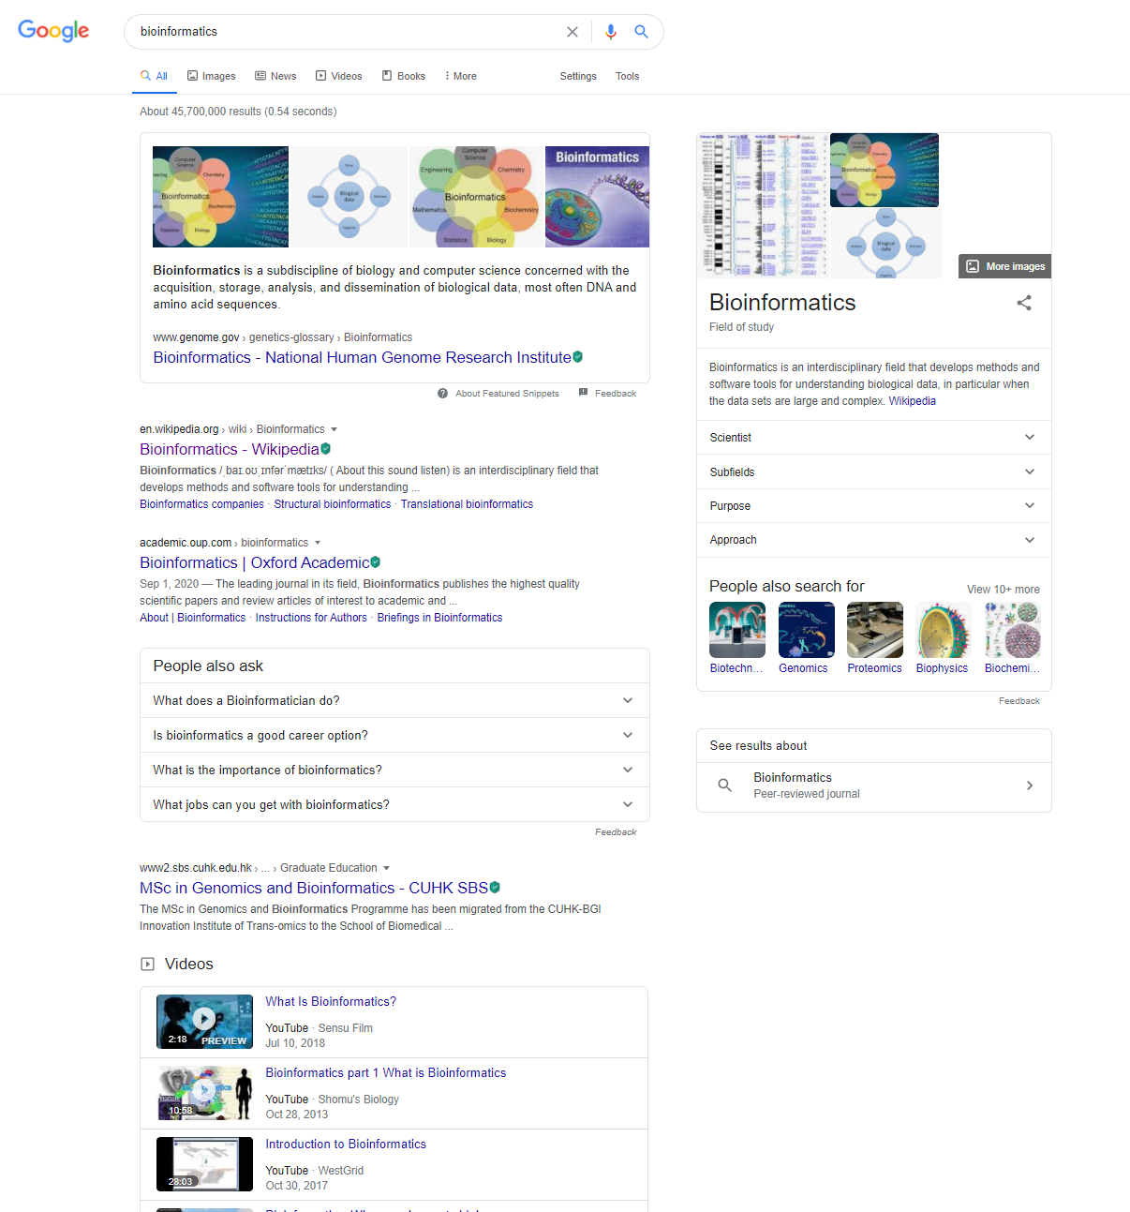
Only Definition!!!

Slide 10
Solution

Slide 11
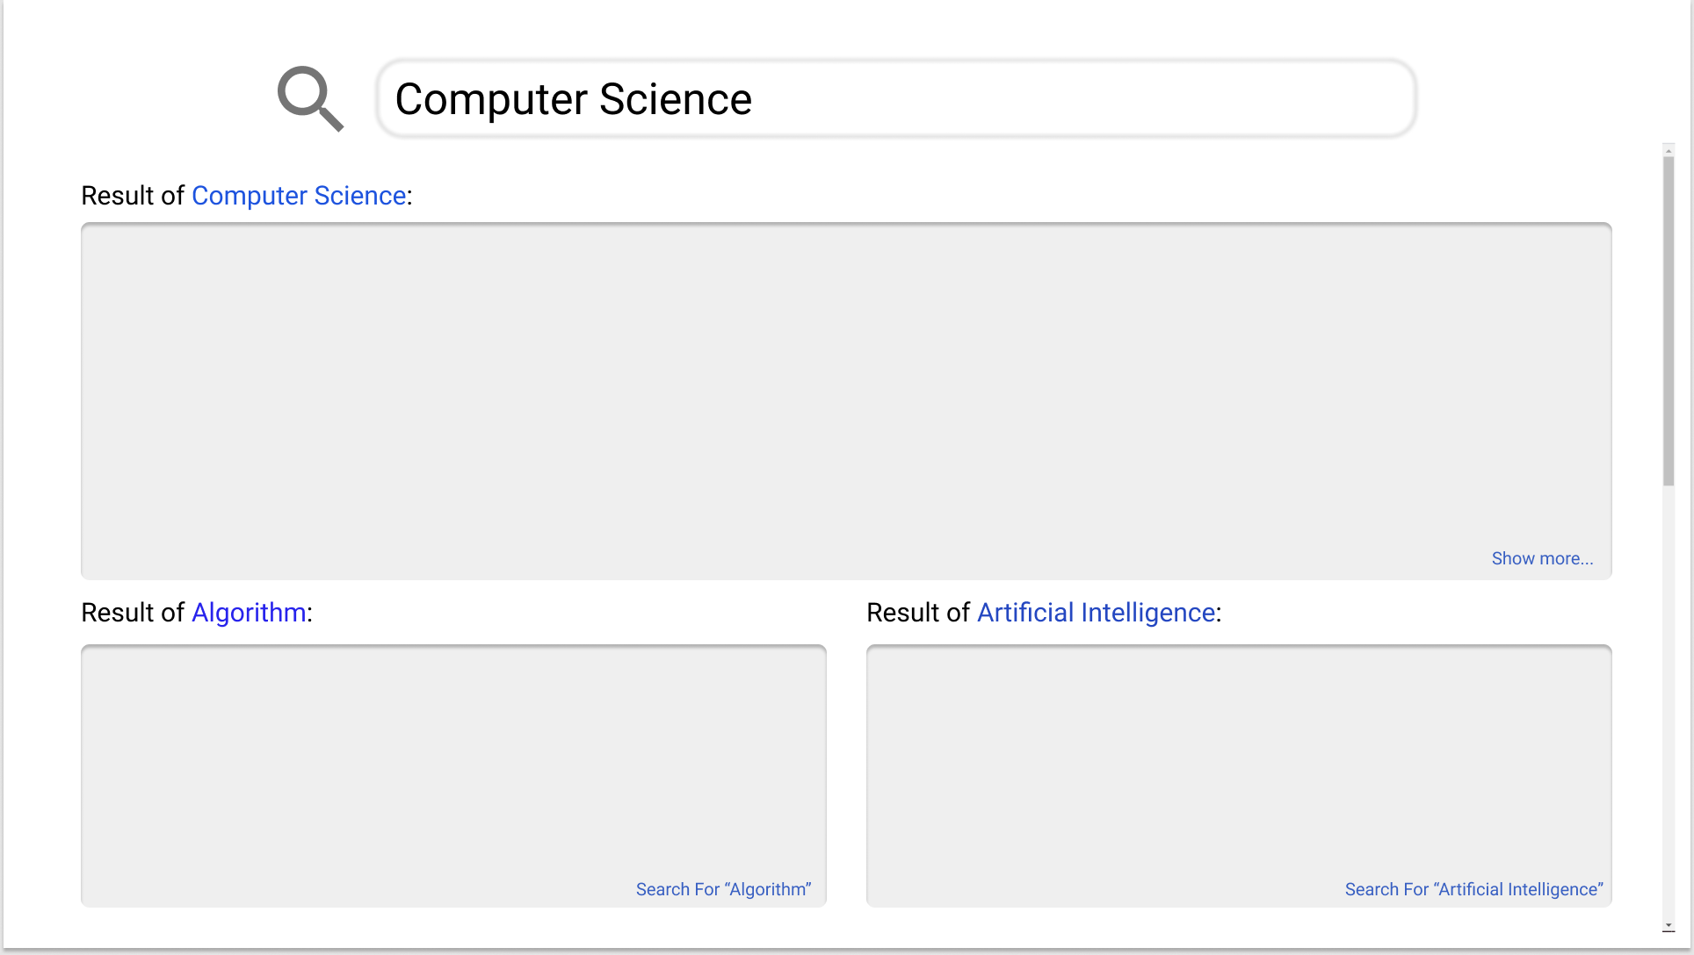

Slide 12
How?

Slide 13
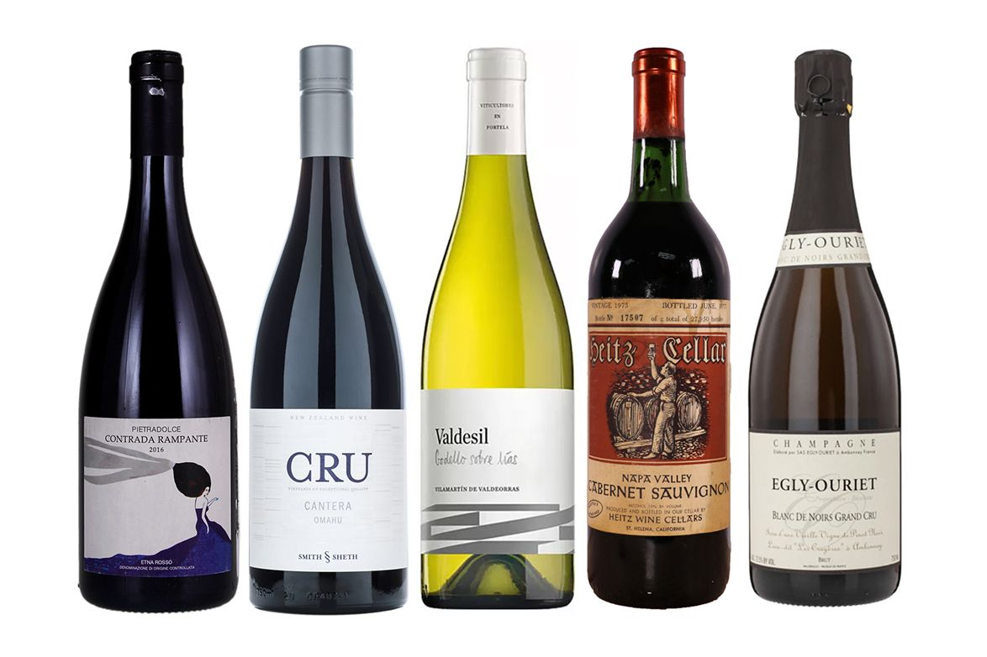


Ontology
is-a
is-a

Slide 14





Slide 16
Implementation & Result

Slide 17
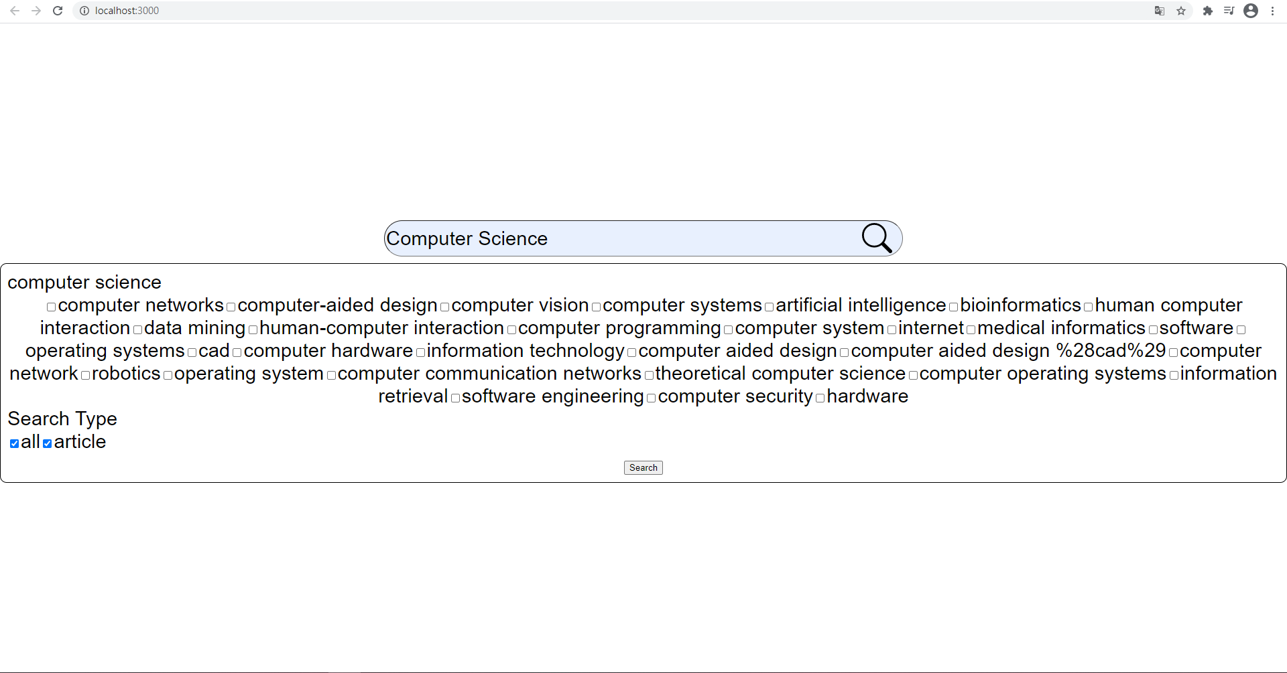

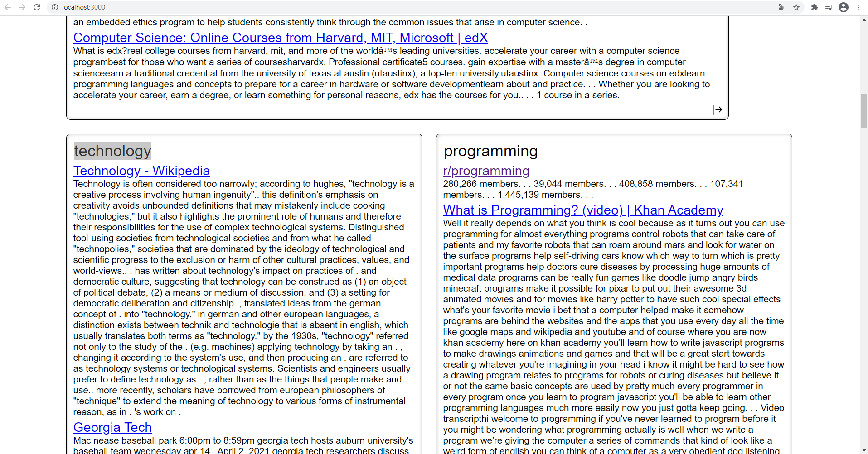
Domain-Specific Search

Slide 18





HTML Documents
Keyword
Ontology Learning
Ontology Tree
Statistic Calculation
Keyword
Sub-Class

Slide 19
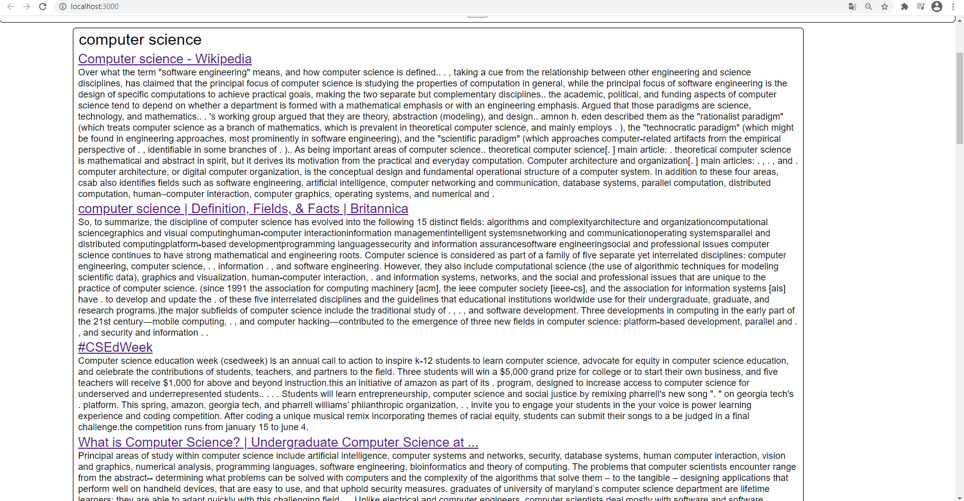

Text Summarization
HTML
Extractive Text Summarization
URL
Summary

Slide 20
Conclusion & Future Improvement

Slide 21


Conclusion
Provide an alternative way and increase the feasibility of online self learning
Reduce the effort needed to learn a new concept
User do not need to have prior knowledge on the searched topic
Future Improvement
Automatic Ontology Learning (Other than Statistic Method)
Extractive Text Summarization -> Abstractive Text Summarization
Document Type

Slide 22
Thank you

Slide 23

Q&A

